Slide 1
The Biology of Trauma
Elaine K Hammond, LMSW
University at Buffalo
School of Social Work
ehammond@buffalo.edu

Slide 2
Introduction

Slide 3
Psychological trauma is the loss of faith that there is order and continuity in life. Trauma occurs when one losses the sense of having a safe place to retreat within or outside oneself to deal with frightening experiences or emotions. This results in a state of helplessness, a feeling that one’s actions have no bearing on the outcome of one’s life. Since human life seems to be incompatible with meaninglessness and lack of control, people will attempt to avoid this experience at just about any price, from abject dependency to psychosis
(van der Kolk, 1987)

Slide 4
Trauma happens to us, our friends, our families, and our neighbors.
As human beings we belong to an extremely resilient species….(b)ut traumatic experiences do leave traces…(t)hey leave traces on our minds and emotions, on our capacity for joy and intimacy, and even on our biology and immune systems.
While we all want to move beyond trauma, the part of our brain that is devoted to ensuring our survival (deep below our rational brain) is not very good at denial. Long after a traumatic experience is over, it may be reactivated at the slightest hint of dancer and mobilize disturbed brain circuits and secrete massive amounts of stress hormones. This precipitates unpleasant emotions, intense physical sensations, and impulsive and aggressive actions. These posttraumatic reactions feel incomprehensible and overwhelming. Feeling out of control, survivors of trauma often begin to fear that they are damaged to the core and beyond redemption.
(van der Kolk, 2014)

Slide 5
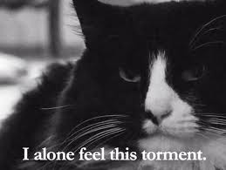

Slide 6
We stop asking:
“What is wrong with this person?” and begin asking….
“What has happened to this person?”
Sickness Model
What’s Wrong With You?!
Sickness implies that the cause of the problem is within the sufferer
Sickness implies individual weakness or defect and stabilization
may be all we can do
Sickness implies passivity, helplessness
Sickness relies largely on “expert” knowledge; patients are expected
to be “compliant” and are reprimanded if they are not
Sickness denies personal and social accountability

Slide 7
Injury Model
What’s happened to you?
Includes physical, psychological, social,
and moral forms of injury
Includes deprivation, neglect, and developmental
insult
Implies rehabilitation process that is mutual, long
term: Requires active collaborative relationship
between helper and injured party
Removes stigma and shame
Provides understandable shared framework
Increase in compassion, increase in expectations
Includes relational aspects

Slide 8
Trauma Informed Practice:
Will avoid inadvertent retraumatization and will facilitate consumer participation in treatment (Harris & Fallot, 2001)
5 Pillars of Trauma Informed Practice
Safety
Trustworthiness
Choice
Collaboration
Empowerment

Slide 9
The Basics

Slide 10
The brain and survival
Identifying and generating internal signals for bodily needs
Mapping where the external world provides those needs
Generating energy for acquisition
Identifying opportunities and challenges
Adjusting our actions in the moment

Slide 11
It develops bottom to top
The reptilian brain
  Moment to moment registration of physiological needs
The mammalian brain
  The limbic system
  Comfort and safety, pleasure and pain
  What fires together, wires together
The rational brain
  30% of volume
  Last to develop
  Easily taken off-line
  Empathy and mirroring

Slide 12
Your brain on crisis: fight/flight/freeze
Neurohormonal Effects
  Lower serotonin (impulsivity, sleep problems, aggression)
  High levels of endogenous opioids (numbing, interferes w/memory)
  High levels of catecholamines (epinephrine & norepinephrine: anxiety, panic, interferes w/memory)
  Chronic stress: depletion of endogenous opioids
  Broca’s area (speech) offline
  Brodman’s area 19 (internal visualization) fully activated

Slide 13
Hypothalamic-Pituitary-Adrenal (HPA) Axis
SNS: (Sympathetic nervous system)
  Prepare for Threat
  Adrenal glands: hormones to prepare for fight, flight or freeze.
  Epinephrine and norepinephrine
PNS: Reestablish Homeostasis (Parasympathetic Nervous System)
  Pituitary & Adrenal Glands: hormones to bring body back to normal (rest/recovery)
  Cortisol, glucocorticoids (endogenous opioids)
Notes:
Inflammation!!!

Slide 14
Psychophysiological Effects
Extreme autonomic arousal (e.g., heart rate, blood pressure) to stimuli reminiscent of the trauma
Hyperarousal to intense, but neutral stimuli (loss of stimulus discrimination)

Slide 15
3 types of disruption
Threat perception system
  The primitive or reptilian brain
Filtering system
  More advanced or mammalian brain
Sense of self
  Rational brain

Slide 16
Information Processing & The Brain
Left Hemisphere Right Hemisphere
Language Production Evaluates emotional sense data content and sensations
Stores Narrative Data Integrates Sense
Cognitive Analysis
Declarative/Explicit Non- declarative/Implicit

Slide 17
Memory Processes and Trauma
Pre-Frontal Cortex
Integration and
Planning
Five Senses
Thalmus
Hippocampus
Cognitive Map
Amygdala
Emotional Significance

Slide 18
Emerging Information

Slide 19
The body keeps score…
GI issues:
  Upset stomach, Butterflies, Nausea, Diarrhea/constipation
Headache
Back Pain
Limb pain/numbness
Tightness in chest
Heart racing/palpitations
Body heaviness – sense of slow motion
Tingling sensations
Muscle tension:
  Brow, jaw, fists, shoulders, abdomen, thighs, toes
Sweating
Difficulty swallowing/lump in throat
Sore throat/dry mouth
Watering eyes/tearing/loss of peripheral
vision/tunnel vision/”going dark”
Ringing in the ears, temporary loss of hearing
Feeling faint
Feeling “frozen”
Inflammatory disorders
Changes in breathing
  Shortness of breath, shallow breath/quickened breath

Slide 20
Is there a fourth state?
Tend and befriend
  Oxytocin
  Implicated in physical ramifications of childhood trauma, especially relational traumas
  May allow us to access action and competence in crisis on behalf of others
  May have implications in “Stockholm syndrome” reactions and patterns of return to site of injury and/or perpetrator of injury
  Olff, M. Eur J Psychotraumatol. 2012; 3: 10.3402/ejpt.v3i0.18597.
  Seng, J. S. J. Trauma Dissociation. 2010 Oct; 11(4):387-406

Slide 21
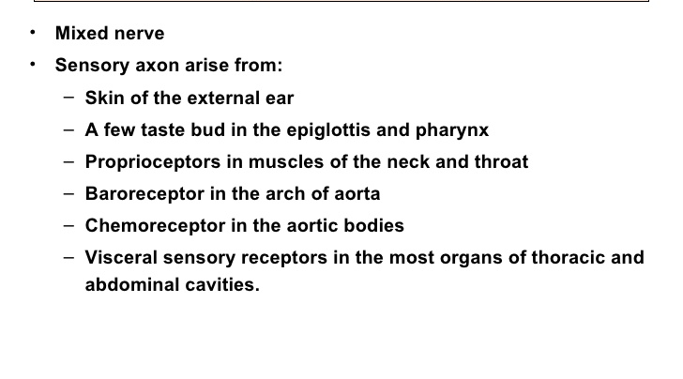
The vagus nerve

Slide 22
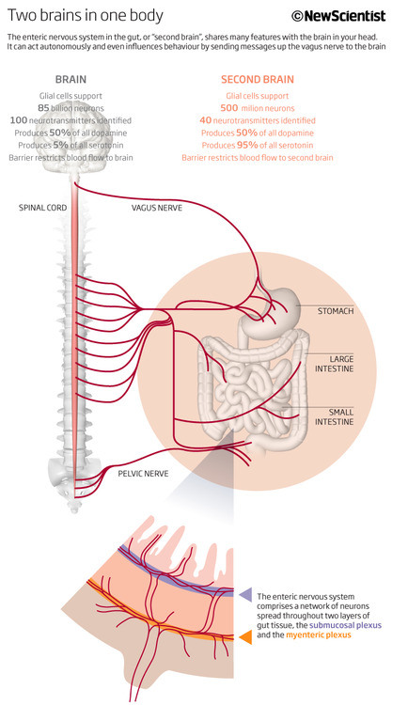

Slide 25
And finally…

Slide 26
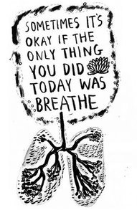
…a brief word from our sponsor…
If you are breathing, there is more right with you than there is wrong.
Jon Kabat-Zinn

Slide 27

What we drag around may impair our ability to move again in community with others…and with ourselves
Notes:
Reconciliation…an important – vital part of resilience.

